Slide 1
Table Header
Hepatitis C Allies of Philadelphia August 2, 2017

Slide 2
About NASTAD
NASTAD is a leading non-partisan non-profit association that represents public health officials who administer HIV and hepatitis programs in the U.S. and around the world.
We strengthen domestic and global governmental public health through advocacy, capacity building, and social justice.

Slide 3
Our Mission and Vision
NASTAD’s mission is to end the intersecting epidemics of HIV, viral hepatitis, and related conditions by strengthening domestic and global governmental public health through advocacy, capacity building, and social justice.
NASTAD’s vision is a world free of HIV and viral hepatitis.

Slide 4
NASTAD Hepatitis History
NASTAD was founded in 1992 as a voice for states
Included harm reduction in program and policy work since founding
Launched hepatitis program in 2000
Support and technical assistance to hepatitis coordinators
Incorporated hepatitis into mission in 2006
Held first hepatitis technical assistance meeting in 2008
Program has grown from one staff to 6+
Integrate hepatitis across all program and policy teams
Initiated Beth Weinstein Drug User Health Fellow in 2015
CDC HCV testing cooperative agreement in Fall 2016
HRSA HAB co-infection cooperative agreement in Fall 2016
Notes:
A quick history of NASTAD’s hepatitis work.
<at end of slide acknowledge how excited we are to have two new hepatitis staff people joining our team> Alyssa Kitlass who is here this afternoon and will be working on our new CDC HCV testing cooperative agreement
Dan Czajka (Saka) who will join us tomorrow and will be working on our new HRSA HAB co-infection cooperative agreement

Slide 5
Hepatitis
The Hepatitis team focuses on increasing the capacity of state and local HIV and hepatitis health department programs to effectively integrate hepatitis prevention and care services into existing programs and enhance services to populations at risk for infection.
NASTAD works closely with state and local viral hepatitis prevention coordinators (VHPCs), providing technical assistance and advocating on their behalf.

Slide 6
Hepatitis Appropriations Partnership
NASTAD convenes HAP, a national coalition based in Washington, D.C. that includes community-based organizations, public health and provider associations, national hepatitis and HIV organizations and diagnostic, pharmaceutical and biotechnology companies from all over the country.
HAP works with federal policy makers in Congress and the Executive branch and with public health officials to increase federal support and funding for hepatitis prevention, testing, education, research, surveillance, and treatment.

Slide 7
NASTAD’s Call to Action
NASTAD recently released a document calling for action on hepatitis that:
Provides recommendations for a range of stakeholders;
Frames elimination as a health equity and social justice issue;
Urges stakeholders to:
prioritize primary prevention, testing, and vaccination among PWID;
eliminate treatment access barriers and prioritize HCV treatment for PWID; and
address the intertwined epidemics of substance use, mental health, overdose prevention ,etc.
Notes:
We will not eliminate hepatitis C in the U.S. unless we have a specific focus on the prevention, care, and intertwined needs of people who inject drugs
This prioritization must include political will, increased funding, and a social justice approach

Slide 8
NASTAD’s Vision for Elimination
NASTAD’s vision is that new HCV infections in the United States are rare, and when they do occur, every person, regardless of substance use status, incarceration status, age, gender, race/ethnicity, sexual orientation, gender identity, disability, socio-economic status, or geographic location, will have access to quality, affordable health care including comprehensive screening, care, and treatment leading to cure, without stigma and discrimination.

Slide 9
Hepatitis Testing Partnership
A coalition of key stakeholders including governmental public health, community based organizations, health systems, primary care providers, community health centers, substance use and mental health service providers, advocates, and patients to share strategies, best practices, lessons learned, and materials developed
Active listserv and quarterly calls
The goal of this group is to accelerate implementation of the CDC testing recommendations in jurisdictions across the country.

Slide 10
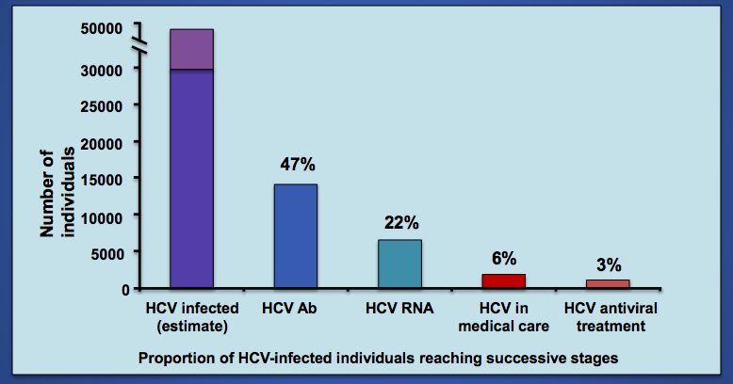
Philly’s Hepatitis Cure Cascade

Slide 11
Increasing Hepatitis Testing in Philly
Where can people get an antibody test for hepatitis C? Reflex test?
What barriers exist to testing?
What helps facilitate testing?
What partners need to be engaged to identify people who are most at need?
How can NASTAD and our Hepatitis Testing Partnership support you at the local level?
Notes:
We see some major drops off when it comes to screening and confirmatory testing. What is causing this?

Slide 12
Contact Us
Alyssa Kitlas
Manager, Hepatitis
akitlas@NASTAD.org
NASTAD
444 North Capitol Street NW, Suite 339
Washington, DC 20001
Phone: (202) 434.8011

